Slide 1

English Tenses for beginner
Muhammad Noor ( 05111850010003 )

Slide 2
Background & Problems
Tense is a category that expresses time reference with reference to the moment of speaking. Main tenses found in many languages include the past, present, and future. (https://en.wikipedia.org/wiki/Grammatical_tense)
Most students who are not English as a mother tongue have problem to understand and use tense.

Slide 3
Propose
Making a game to help students understanding the pattern and application tenses using Pare’s Culture.

Slide 4
Plot
The game tells the story of a student studying tenses to take an English exam at his school.
The game has 3 main chapters:
Chapter 1: At student’s home, at night before an exam when he studying tense.
Chapter 2: On the way from home to school where the student has a conversation with other people.
Chapter 3: At school, the student takes an English exam.

Slide 5

Chapter 1
In this section, students will learn tenses according to the pare’s culture.
Tenses terdiri dari 3 bagian :
Past, Present, Future
Tenses Terdiri dari 4 Kondisi :
Simple, Continous, Future, Past Future
Present | v1 (s, es)
Past | v2
Future | will, shall + Vbi
Perfect | have + v3
Continuous | be + V-ing
Nominal | be + 3 Complement (Adjective , Noun , adverb)
Passive | be + V3
Perubahan | be | have | will / shall
V1 (s/es) | is / am / are | have / has
V1 (bi) | be | have
V2 | was / were | had | would / should
V3 | been

Slide 6
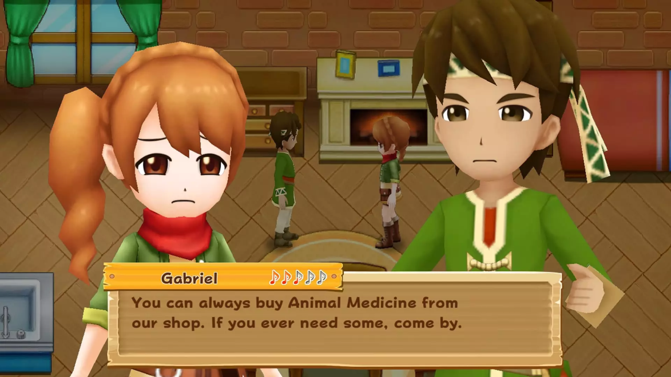
Chapter 2
In chapter 2, students on their way from home to school meet several people and hold talks. Students must choose questions or answers according to what is conveyed by others.
Answer :
Go to school
I go to school
I am go to school
I am going to school
Where are you go ??

Slide 7
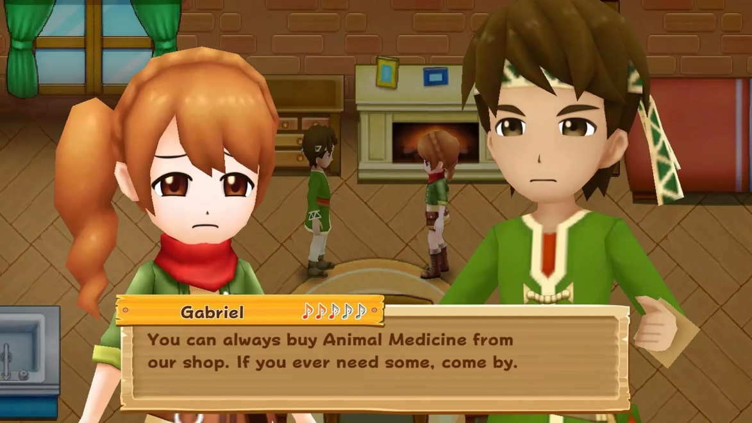
Chapter 2
You choose the wrong answer !!
Correct answer :
d. I go to school
(simple present)
Where are you go ??
If the answer is correct, students continue their journey to school and meet other people.
If the answer is wrong, students will get an explanation of which answer is correct.

Slide 8

Chapter 3
In this chapter, students take an exam about tenses. the questions are given related to tenses that have been studied
Question : Future Perfect Continous (Verbal Aktif Positif)
Answer :
S + will, Shall + have + V3 (+ O + Adv)
S + Would, Should + be + V3
S + will, Shall + have + been + V-ing (+ O + Adv)
S + had + been + V-ing (+ O + Adv)

Slide 9
Terima Kasih Matur Nuwun Hatur Nuhun Thank You Shukraan Lak Danke XieXie Dhanyavaad Arigato Bedankt Grazie Gomawo Merci Blagodaryu Vas Gracias

